Slide 1

Low Latency Interest Rate Markets
Theory, Pricing & Practice
Nicholas Burgess

Slide 2
PART ONE: Theory
IR Markets, Products & Models
Introduction to IR Markets
Interest Rate Swaps
IR Products & CDS
Yield Curves
IR Risk
Credit Models
PART TWO: Pricing & Practice
Case Studies
IRS Pricing Formulae
IRS Pricing Case Study
Asset Swap Structuring
Asset Swap Pricing Case Study
Pricing Tricks & Rules of Thumb
Quant Research Papers
https://ssrn.com/author=1728976
Support Materials: Quant Research, C++ and Excel Examples
https://github.com/nburgessx/SwapsBook

Slide 3
PART ONE - THEORY
IR Markets, Products & Models

Slide 4
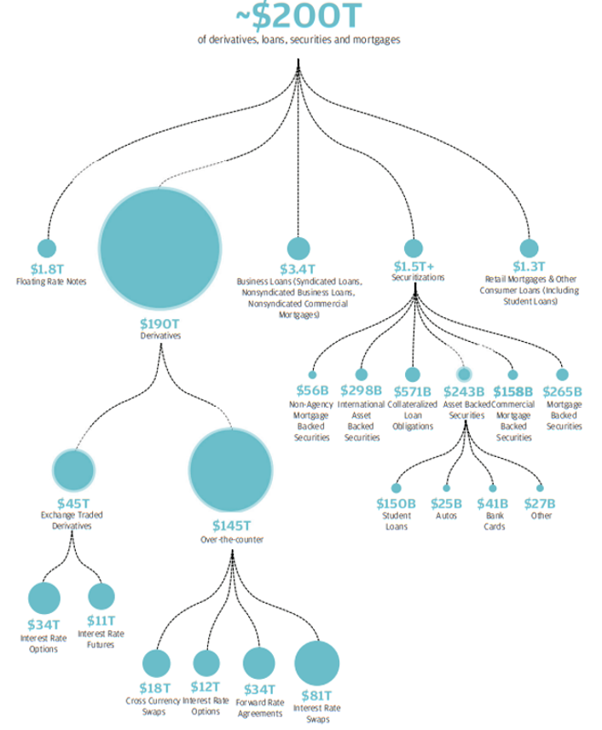
Interest Rate Markets - Project Finance
Purpose
To Facilitate Government, Corporate & Project Finance
Mortgages, Corporate Loans, Gov Projects & Infrastructure
e.g. Hospitals, Transport (HS2), Energy & Defence Projects
Market Size
Market Size by Notional: $200T (US) + $150T (EU)
Derivatives, Loans & Securities
All Referencing LIBOR, until Recently

Slide 5
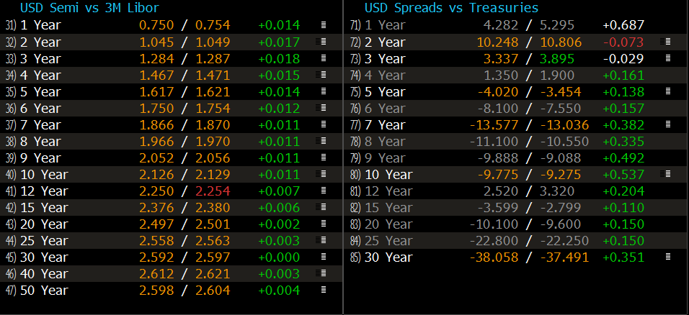
Interest Rate Markets – Why the need for Speed?
Cleared Electronic Trading & Auto-Hedging
Real-Time, Highly Liquid & High Precision (Bid-Offer 1/10th bps i.e. USD 10 per MM)
Trading Horizon: High Frequency Trading (HFT) vs Long-Term Fund Performance

Slide 6
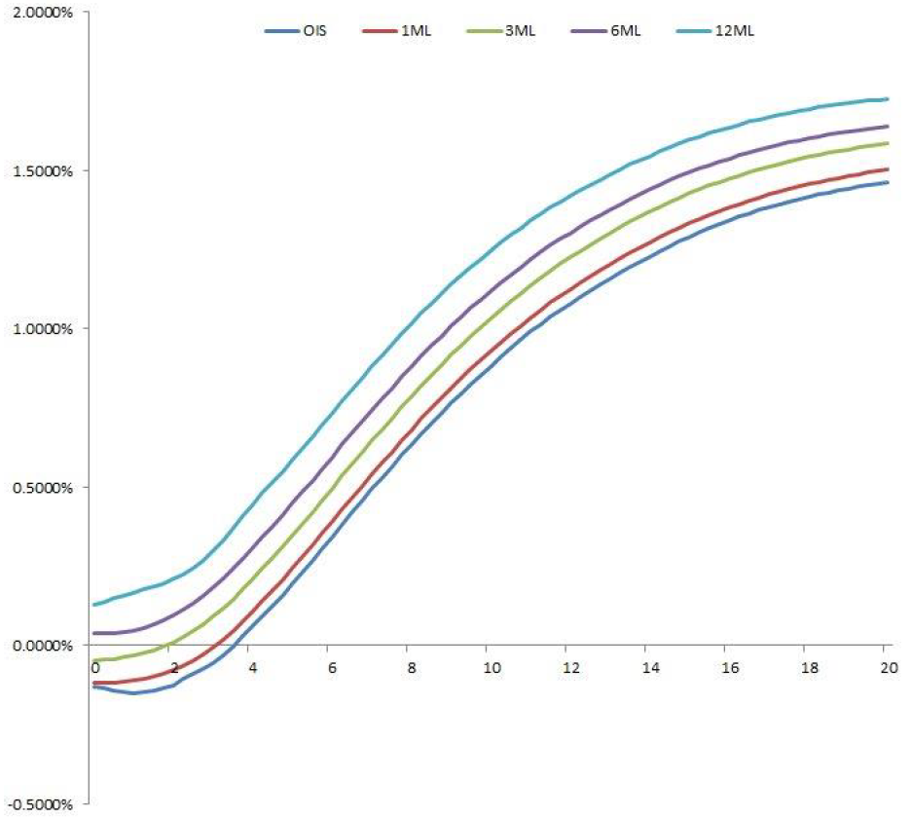
Interest Rate Markets – Models
Need to Forecast Future Interest Rates
Use Liquid Market Instruments
To Imply Forward Rates & Disc. Factors
Yield Curve Model Dynamics
Multi-Curves Have In-Built Credit Spread (Tenor Homogenous)
Credit Spread Determined by Loan Repayment Frequency
Being Replaced by Single RFR Curves (Similar to OIS Curve)

Slide 7
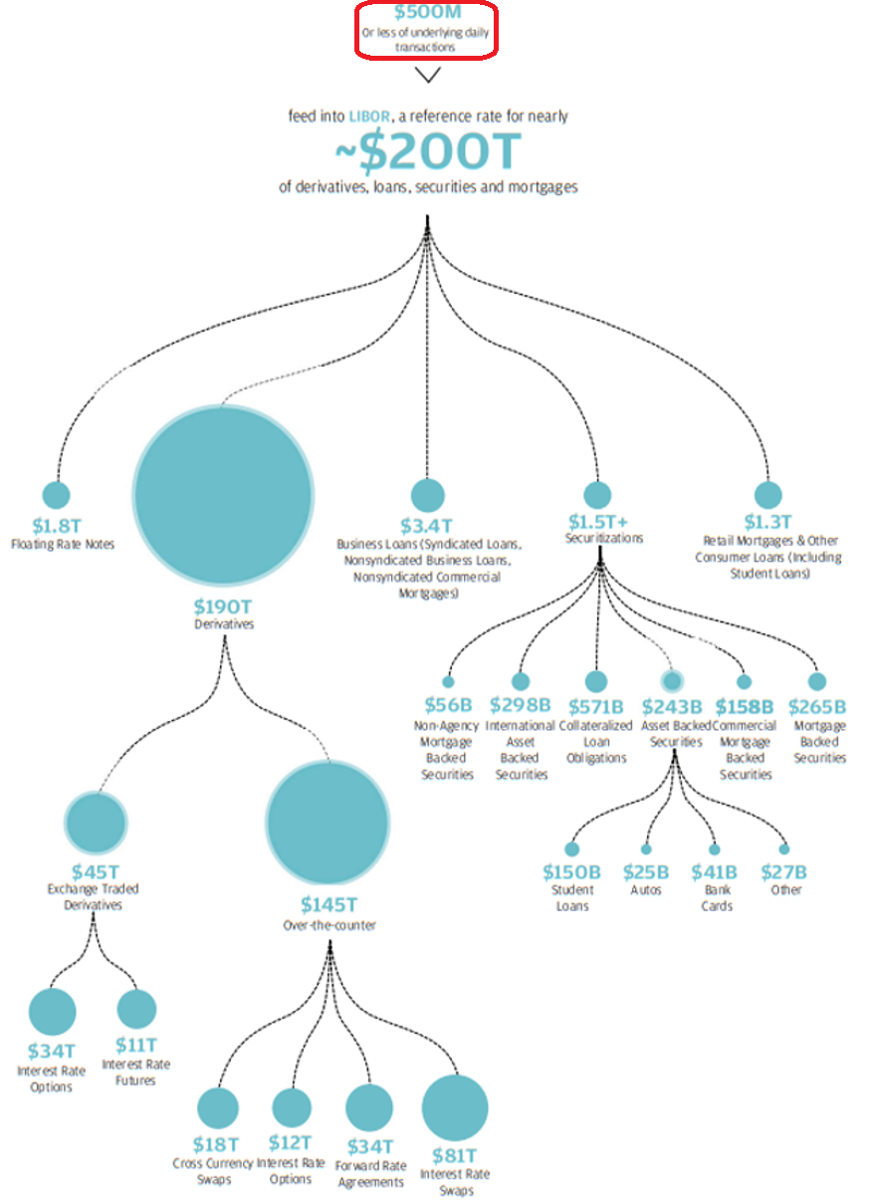
Interest Rate Markets – The LIBOR Problem
The Problem with LIBOR
LIBOR Market Transactions < $500M
Rates Do Not Reflect Actual Borrowing Levels
LIBOR Levels Increasingly Set by Panel/Expert Judgement
Market Size
Market Size by Notional: $200T (US) + $150T (EU)
Large Market Driven by Small Number of LIBOR Transactions!!!

Slide 8
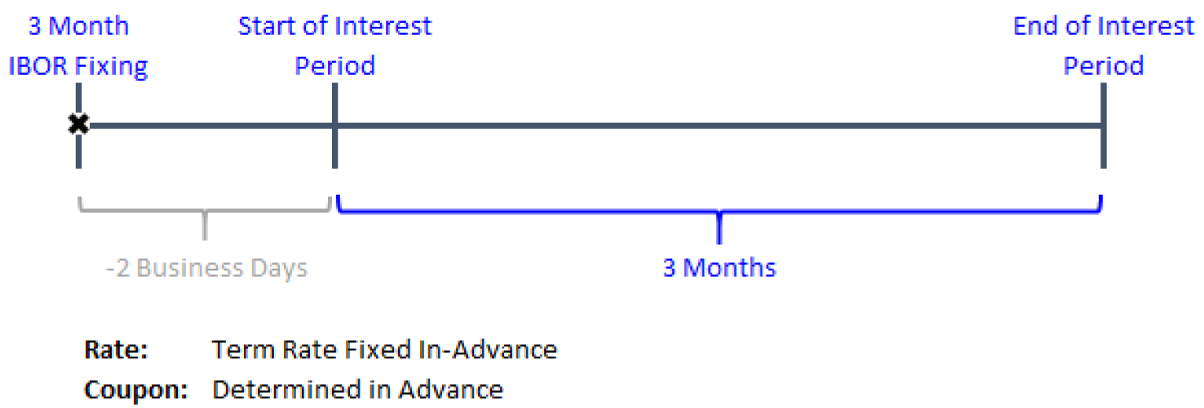
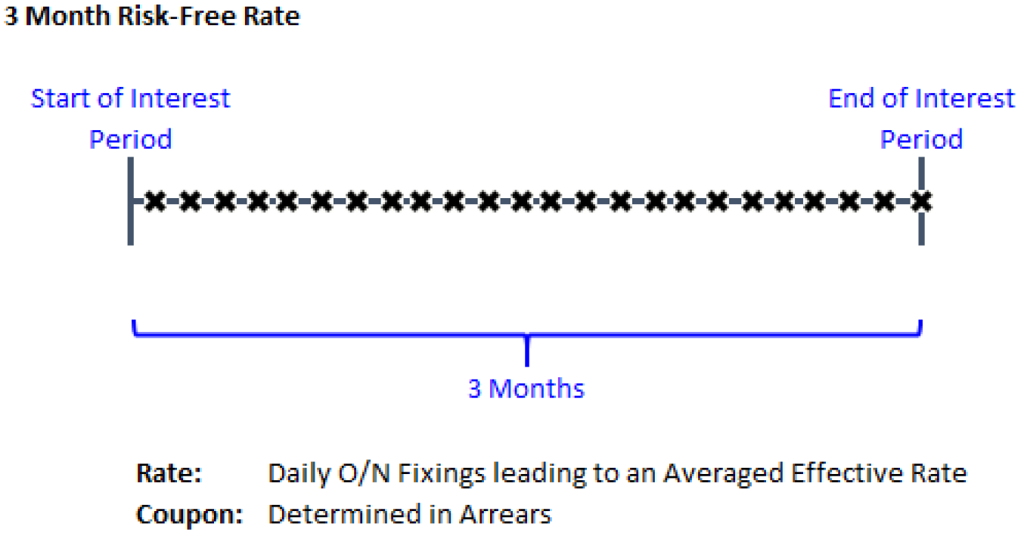
Interest Rate Markets – LIBOR Benchmark Replacement
(Reference)
LIBOR Rates
Low Transaction Volume / Panel Based
Forward Looking Term Rate, known In-Advance
In Built Credit Risk Component
Risk-Free Rates (RFRs)
Transaction Based
Backward Looking Rate, Known In-Arrears
No Credit Component i.e. Risk-Free
Market Changes
Legacy LIBOR Contracts, Fall-Back Rates
New RFR Products & Yield Curve Model Changes

Slide 9
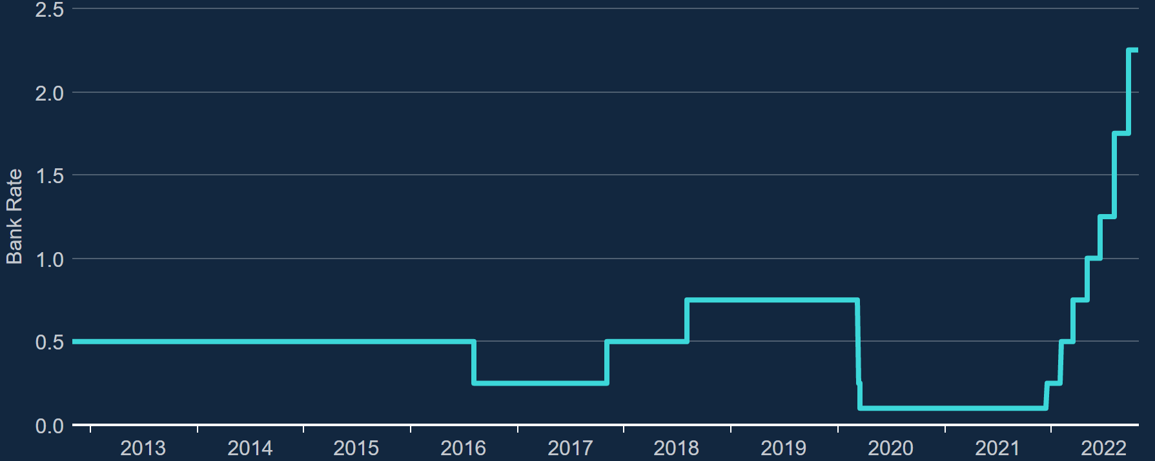
Interest Rate Markets – Project Finance Risks & Solutions
1. Interest Rate Risk
Finance linked to variable interest rates
Use IRS to Fix Borrowing Costs
2. Foreign Exchange / Currency Risk
International Finance
Use Cross Currency Swaps to Fix FX Rates
3. Credit Default Risk
Bonds, Bi-Lateral and Non-Cleared Transactions
Risk of Counterpart Default
Credit Default Swaps, Collateral & CSA Agreements
4. No money to invest?
Use Asset Swaps to Borrow Funds to Invest in Bonds
Pay LIBOR + Spread to Receive Bond Coupons
Floating Spread includes Funding + Credit Costs

Slide 10
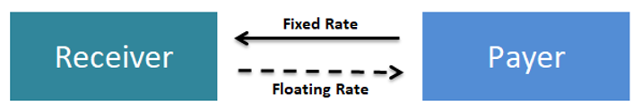
Interest Rate Swaps – Fixed or Variable Borrowing Costs?
Project Finance
Project Finance Incurs Variable Interest Costs (LIBOR + Spread)
Hedging Interest Rate Risk
Swap Floating Interest for Fixed Interest (or Vice Versa)
Traditionally Used to Fix Borrowing Costs
Also for Speculative Purposes

Slide 11
Interest Rate Swaps –Market Quotes & Pricing
Standard Tenors: Spread Over US Treasury Yields
New Swaps: Par Rate (%), since PV=0
Existing Swaps: Present Value (USD)

Slide 12
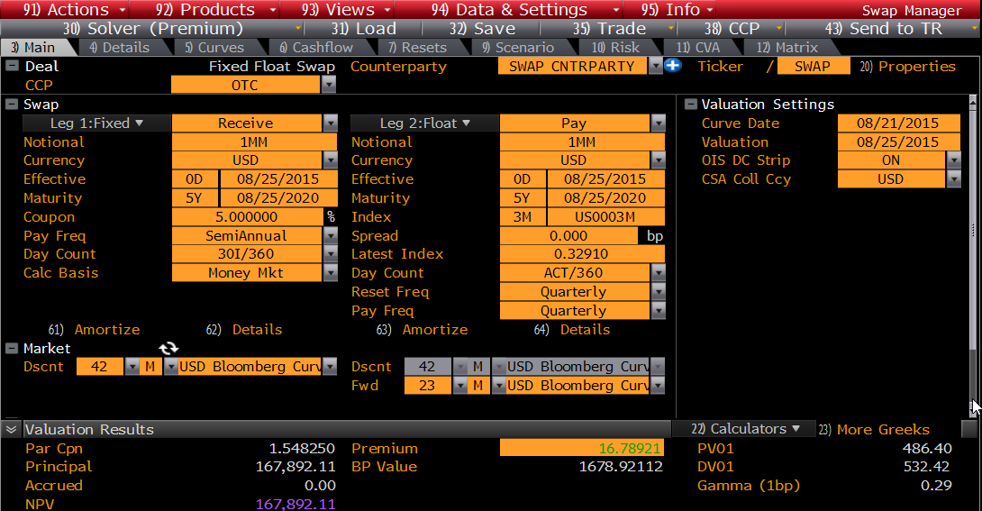
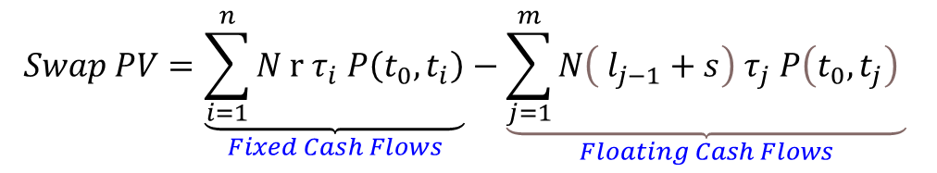
Interest Rate Swaps – Present Value
Present Value is the Sum of Discounted Cash Flows
$$Swap PV=\underset{Fixed Cash Flows}{\underbrace{\sum_{i=1}^{n}{N r τ_{i} P\left(t_{0},t_{i}\right)}}}−\underset{Floating Cash Flows}{\underbrace{\sum_{j=1}^{m}{N\left( l_{j−1}+s\right) τ_{j} P\left(t_{0},t_{j}\right)} }}$$

Slide 13
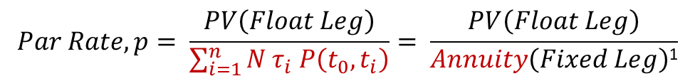
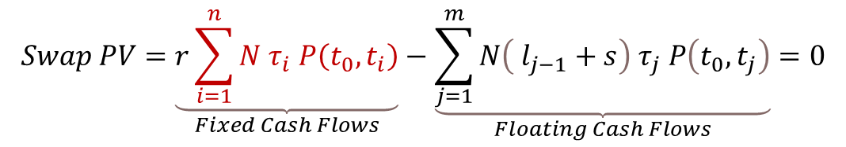
Interest Rate Swaps – Par Rate
New Swaps Trade at Par i.e. PV = 0
Consequently such Swaps Quote as a Par Rate
This is the fixed rate that makes both trade legs equal
$$Swap PV=\underset{Fixed Cash Flows}{\underbrace{r\sum_{i=1}^{n}{N τ_{i} P\left(t_{0},t_{i}\right)}}}−\underset{Floating Cash Flows}{\underbrace{\sum_{j=1}^{m}{N\left( l_{j−1}+s\right) τ_{j} P\left(t_{0},t_{j}\right)}}}=0$$
Rearrange for the Fixed Rate r and call this the Par Rate, p
$$Par Rate, p= \frac{PV\left(Float Leg\right)}{\sum_{i=1}^{n}{N τ_{i} P\left(t_{0},t_{i}\right)}}= \frac{PV\left(Float Leg\right)}{Annuity\left(Fixed Leg\right)\text{1}}$$
¹ Par Rates calculated in terms of Annuity or PV01

Slide 14
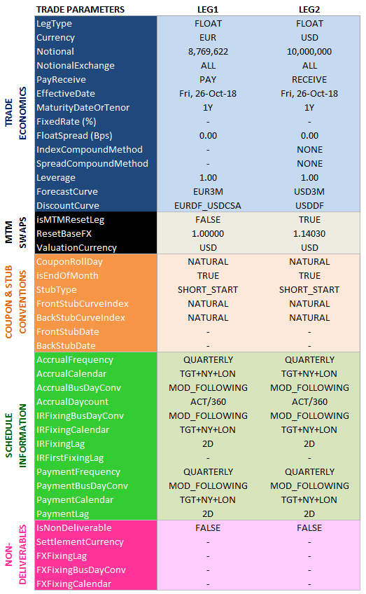
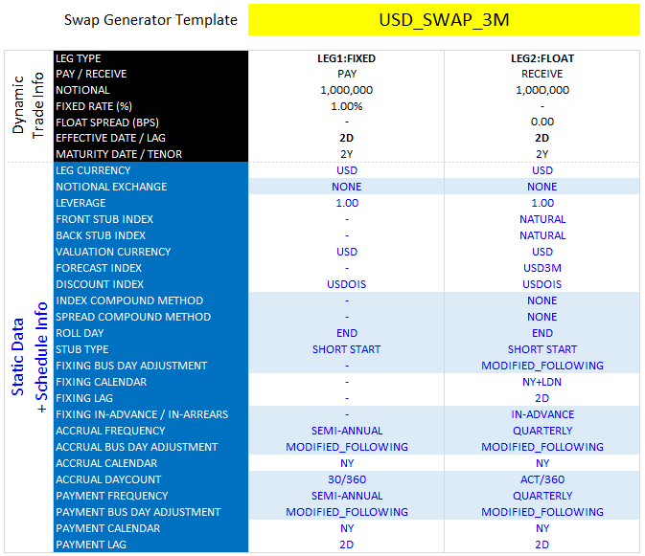
Interest Rate Swaps - Specification
Majority of Swap Booking Schedule Related
Trading Templates, Generators & Static Data

Slide 15
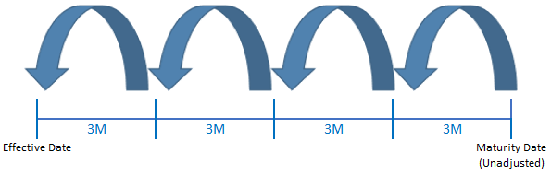
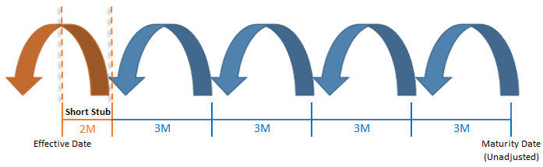
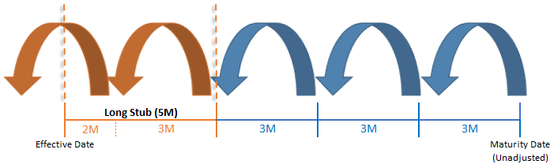
Interest Rate Swaps - Schedules & Stubs
(Reference)
1Y Swap
Swap Schedules
Backwards vs Forward Rolling Schedules
Unadjusted to Preserve Roll Day
Holiday Adjustments Ex-Ante
Accrual Day Count Conventions
1Y2M (Short Start)
Broken-Dated Swaps
Stubs & Stub Rates (Linear Interp)
Short Start/End, Long Start/End
Market Default: Short Start
1Y2M (Long Start)

Slide 16
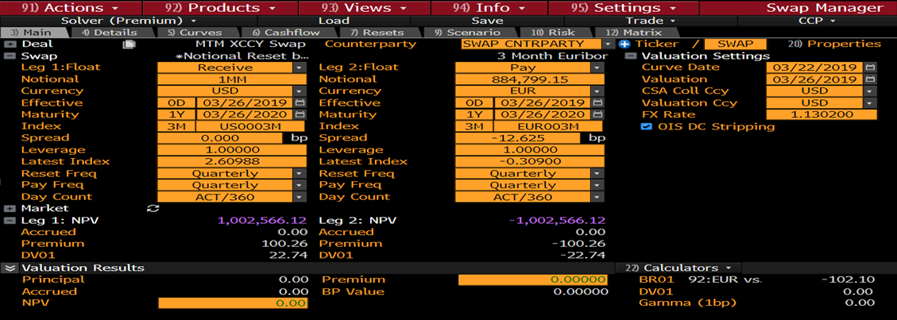
IR Products – Tenor & Xccy Basis Swaps
(Reference)
Tenor Basis Swaps
Float vs Float (Same Currency)
Exchange USD3M for USD6M say
Match Project Cash Flow Frequency
Tenor Basis Swap Formulae (December 30, 2015).
Available at SSRN: https://ssrn.com/abstract=2959605
Xccy Basis Swaps
Float vs Float (Different Currencies)
Exchange USD3M for EUR3M say
Marked-to-Market / FX Notional Resets
Reduces XVA Costs
An Illustrated Step-by-Step Guide of How to Price Cross Currency Swaps (November 11, 2018). Available at SSRN: https://ssrn.com/abstract=3278907

Slide 17
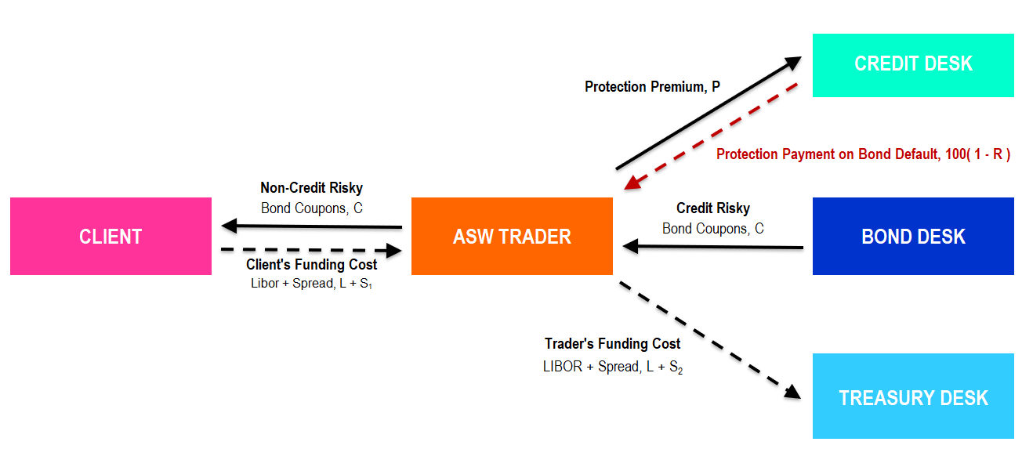
IR Products – Asset Swaps
Asset Swap
Borrow Funds to Invest in Bonds
Client Perspective
Receive Bond Coupons
Pay LIBOR + Spread
Spread Includes Finance + Credit Costs

Slide 18
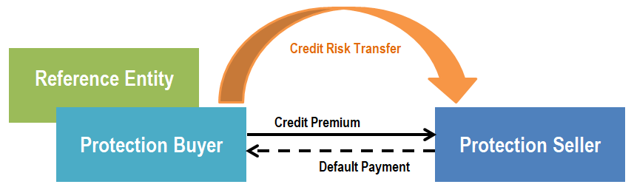
IR Products – Credit Default Swaps (CDS)
Insurance Against Counterparty Default
Insuring Bond Notional Invested
Pay Fixed Insurance Premium
Receive Protection Payment on Default
Credit Crisis & ISDA Big Bang (2008)
Standardized & Cleared Contracts (IMM Dates¹)
Increased Liquidity
Accrued Interest, Clean & Dirty Prices
¹ Third Wednesday of Mar, June, Sep and Dec

Slide 19
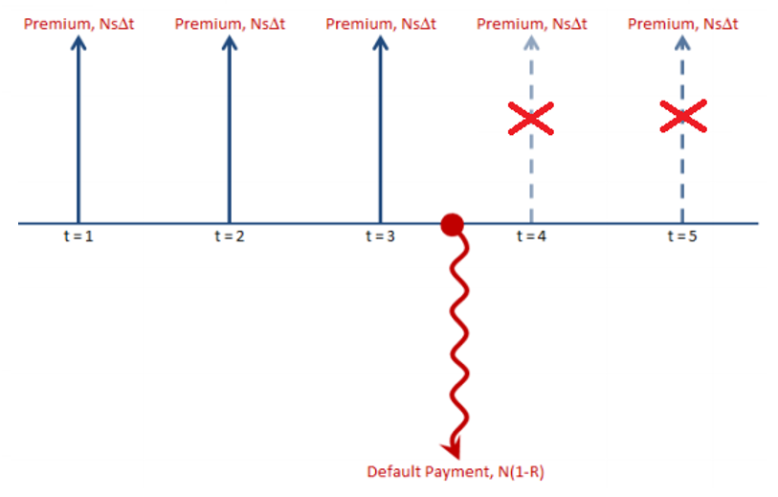
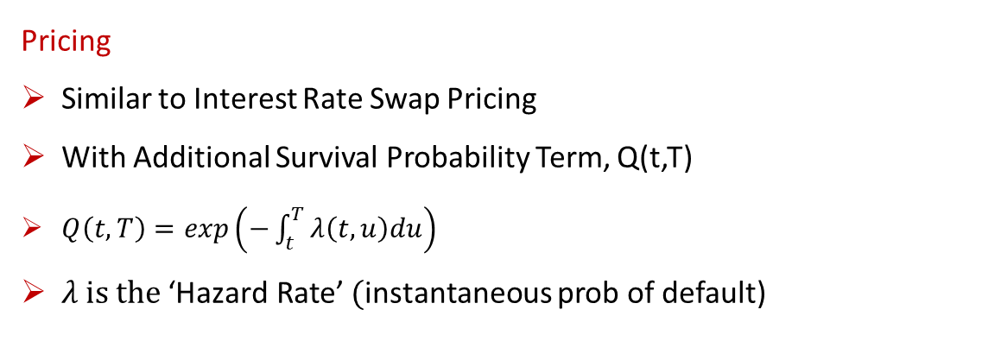
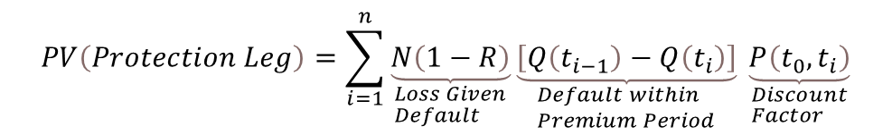
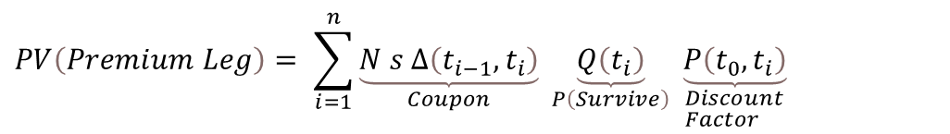
IR Products – CDS Pricing
(Reference)
Pricing
Similar to Interest Rate Swap Pricing
With Additional Survival Probability Term, Q(t,T)
$Q\left(t,T\right)=exp\left(−\int_{t}^{T}{λ\left(t,u\right)du}\right)$
$λ \text{is} \text{the} \text{‘}\text{Hazard} \text{Rate}\text{’} ($instantaneous prob of default)
Buying Credit Protection
$$PV=PV\left(Protection Leg\right)−PV(Premium Leg)$$
$$PV\left(Premium Leg\right)= \sum_{i=1}^{n}{\underset{Coupon}{\underbrace{N s ∆\left(t_{i−1},t_{i}\right)}} \underset{P\left(Survive\right)}{\underbrace{Q\left(t_{i}\right)}} \underset{\begin{aligned}&Discount \\ &Factor\end{aligned}}{\underbrace{P\left(t_{0},t_{i}\right)}} }$$
$$PV\left(Protection Leg\right)=\sum_{i=1}^{n}{\underset{\begin{aligned}&Loss Given \\ &Default\end{aligned}}{\underbrace{N\left(1−R\right)}}}\underset{\begin{aligned}&Default within \\ &Premium Period\end{aligned}}{\underbrace{\left[Q\left(t_{i−1}\right)−Q\left(t_{i}\right)\right]}} \underset{\begin{aligned}&Discount \\ &Factor\end{aligned}}{\underbrace{P\left(t_{0},t_{i}\right)}}$$

Slide 20
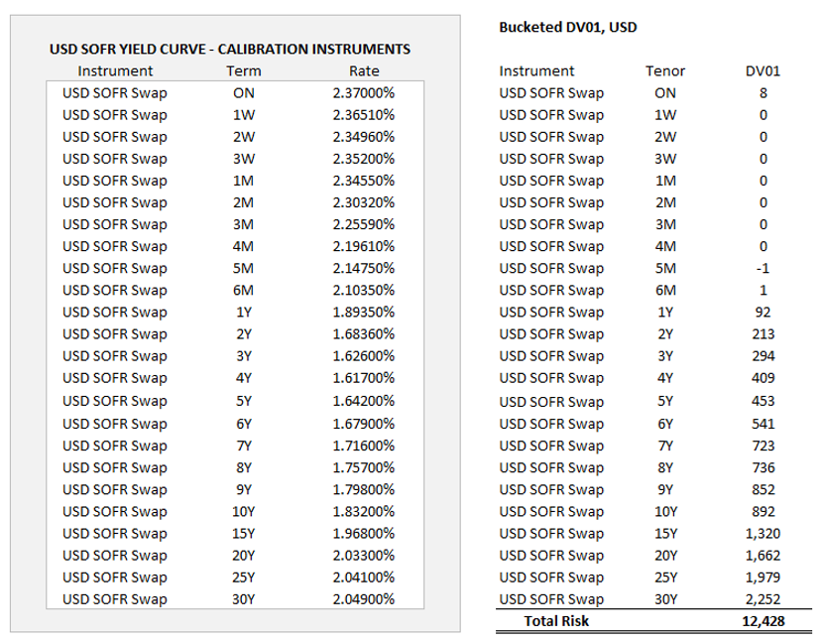
IR Risk
What are the main IR risks?
Discount Risk (DF01)
Forward Risk (PV01)
Discount + Forward Risk (DV01)
Risk Calculation Methods
Analytical
Numerical Risk (Benchmark)
Using Yield Curve Jacobian
Automatic Adjoint Differentiation (AAD)

Slide 21
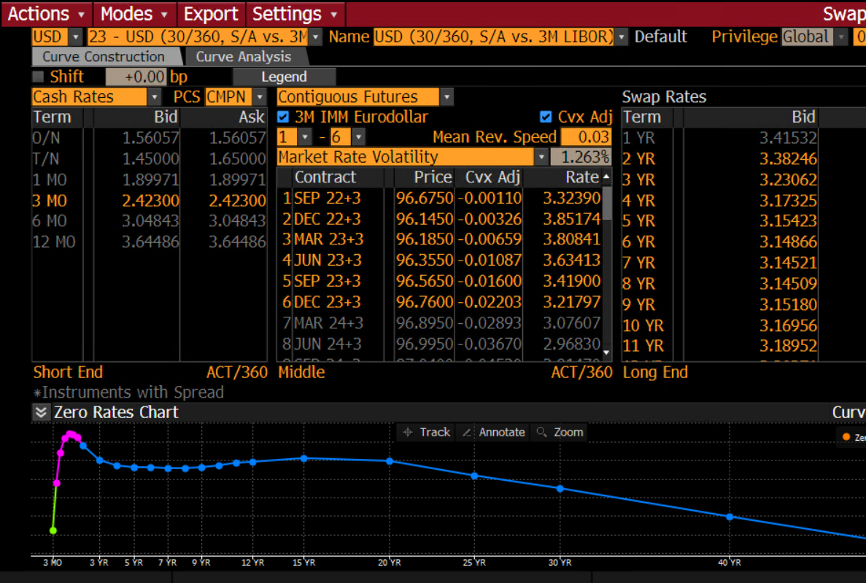
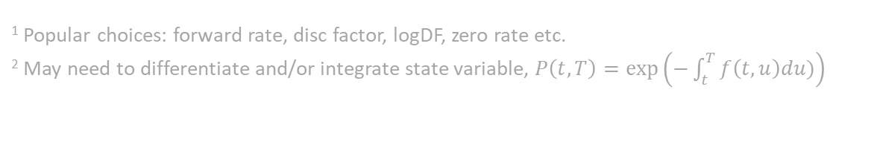
Yield Curves - Calibration
Model Inputs & Outputs
Liquid Market Instrument Quotes [IN]
Forward Rates [OUT]
Discount Factors [OUT]
Calibration Process
Choose State Variable¹
Choose Interpolator / Functional Form
Solve and Imply Forwards & Disc Factors²
¹ Popular choices: forward rate, disc factor, logDF, zero rate etc.
² May need to differentiate and/or integrate state variable, $P\left(t,T\right)=exp⁡\left(−\int_{t}^{T}{f\left(t,u\right)du)}\right)$

Slide 22
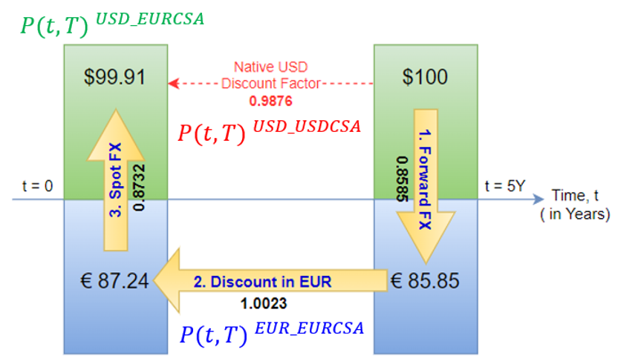
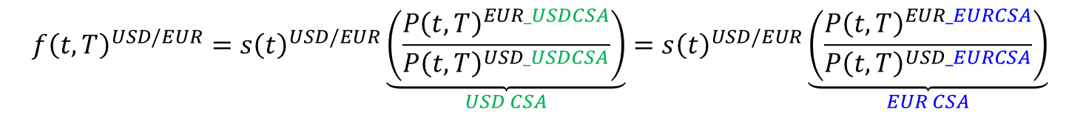
Yield Curves – Collateral & CSA Curves
(Reference)
Collateral & CSA Curves
Calibrate to FX Forwards & Xccy Swaps
FX Forward Invariance (FX Carry Trade)
Impacts Discount Factors Only
No Impact on Forward Rates
Advanced CSA Topics
Cheapest to Deliver (Multiple CSAs)
Collateral Switch Options
$$f{\left(t,T\right)}^{USD/EUR}={s\left(t\right)}^{USD/EUR}\underset{USD CSA}{\underbrace{\left(\frac{{P\left(t,T\right)}^{EUR_USDCSA}}{{P\left(t,T\right)}^{USD_USDCSA}}\right)}}={s\left(t\right)}^{USD/EUR}\underset{EUR CSA}{\underbrace{\left(\frac{{P\left(t,T\right)}^{EUR_EURCSA}}{{P\left(t,T\right)}^{USD_EURCSA}}\right)}}$$

Slide 23
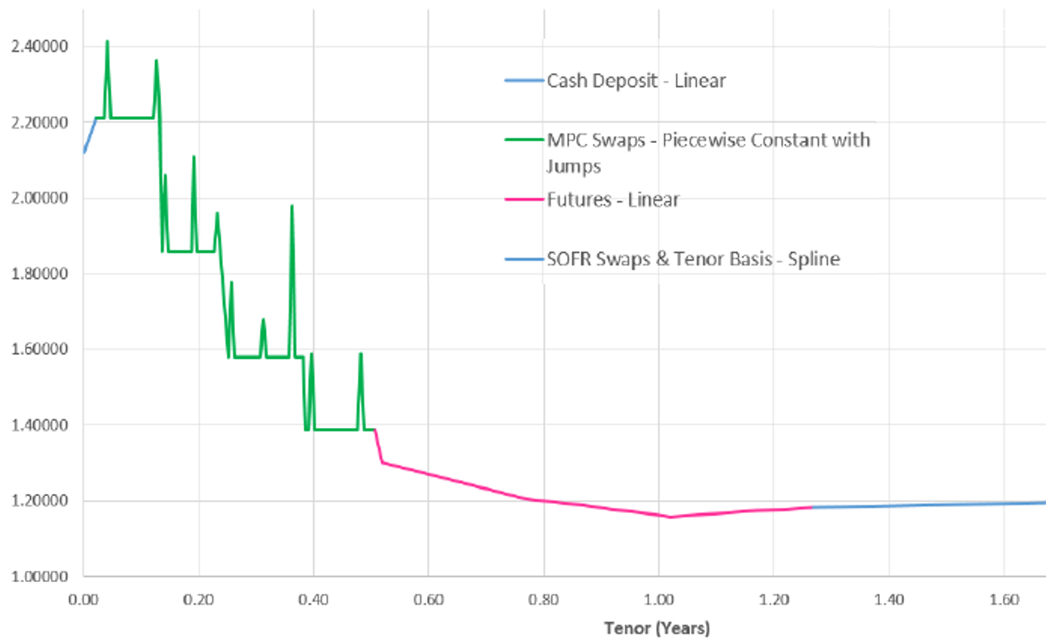
Yield Curves - Features
Features
Instrument Behaviour
Mixed Interpolation Schemes
Turn-of-Year Effects (ToYs)
Advanced Features for Electronic Markets
Curve Jacobian
Ultra-Fast Curves & Analytical Risk
Automatic Adjoint Differentiation (AAD)

Slide 24
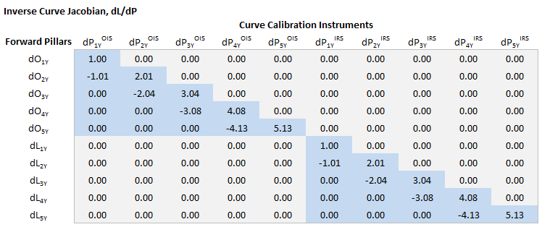
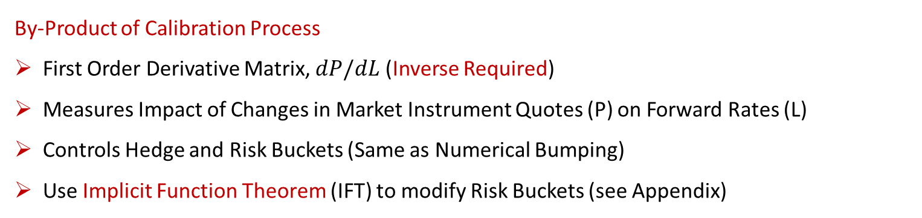
Yield Curves – Curve Jacobian
Electronic HFT Usage
Ultra-Fast Rebuilds
Real-Time Risk
Auto-Hedging
By-Product of Calibration Process
First Order Derivative Matrix, $dP/dL$ (Inverse Required)
Measures Impact of Changes in Market Instrument Quotes (P) on Forward Rates (L)
Controls Hedge and Risk Buckets (Same as Numerical Bumping)
Use Implicit Function Theorem (IFT) to modify Risk Buckets (see Appendix)

Slide 25
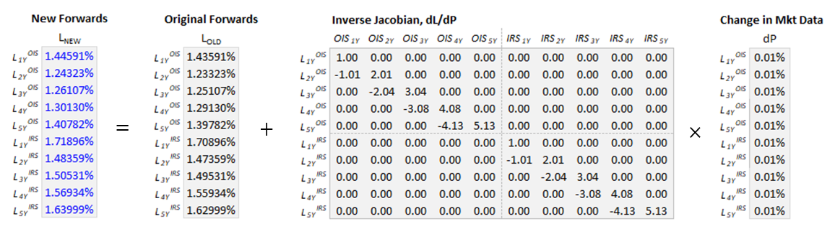
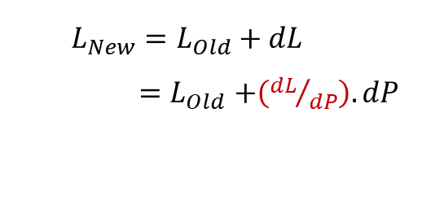
Yield Curves – Ultra-Fast Rebuilds
New Forwards
$$L_{New}=L_{Old}+dL$$
${=L}_{Old}+\left({dL}/{dP}\right).dP$
Implementation
Slow Curve (Full-Rebuild) Ticks in Background (ca. 10ms)
Fast Curve (Jacobian Method) Used Between Refreshes (Real-Time)

Slide 26
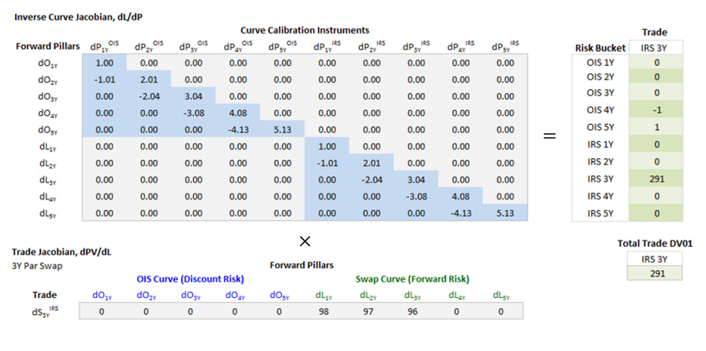
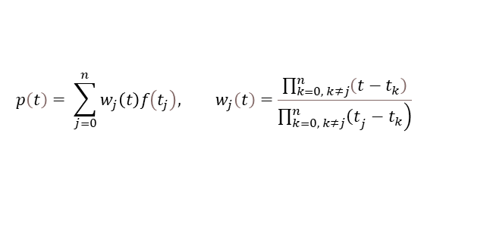
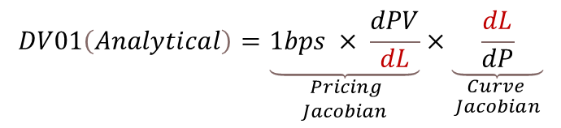
Yield Curves – Real-Time Risk
Requirements
Curve Jacobian
Trade or Portfolio Jacobian
$$DV01\left(Analytical\right)=\underset{\begin{aligned}& Pricing \\ &Jacobian\end{aligned}}{\underbrace{1bps × \frac{dPV}{dL}}}×\underset{\begin{aligned}& Curve \\ &Jacobian\end{aligned}}{\underbrace{ \frac{dL}{dP} }}$$
Risk as a Matrix Operation
Can be Parallelized / Vectorized
Matrix Dimensions Must Agree
Interpolation & Forward Mapping
Barycentric Weights, w_{j}(t)
$$p\left(t\right)= \sum_{j=0}^{n}{w_{j}\left(t\right)f\left(t_{j}\right), w_{j}\left(t\right)=\frac{\prod_{k=0, k≠j}^{n}{\left(t−t_{k}\right)}}{\left.\prod_{k=0, k≠j}^{n}{{\left(t\right.}_{j}−t_{k}}\right)}}$$

Slide 27
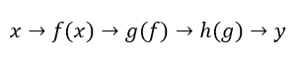
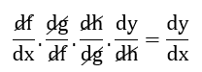
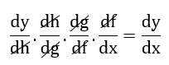
Yield Curves – Automatic Adjoint Differentiation (AAD)
Trade Jacobian
AAD Can Compute Instrument Price & Risk Simultaneously
Direct Differentiation of Code + Implicit Function Theorem (IFT)
Exact & Fast (X4 Pricing Time)
Pricing Calculations
Tangent & Adjoint Modes
Tangent Mode (dot) : Forward Mode - One Risk at a Time
Adjoint Mode (bar) : Backward Mode - All Risks Simultaneously
Activation Inputs Control Risk Outputs
Chain Rule: Forwards
Chain Rule: Backwards
Implementation Methods
By Hand (See Appendix for Swap DV01 Risk Example)
Derivative Code by Overloading, DCO/C++
Professional Tools: Adept, NAG

Slide 28
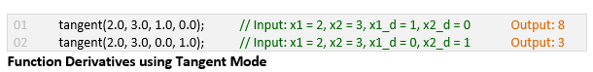
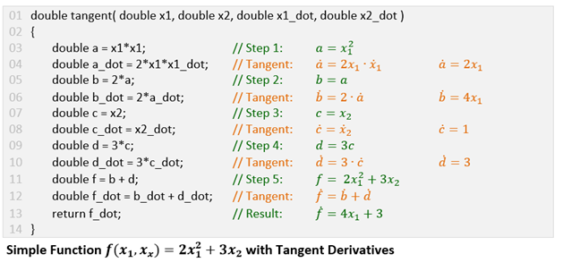
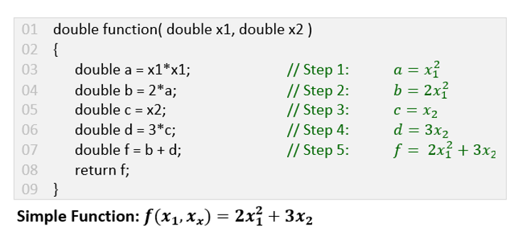
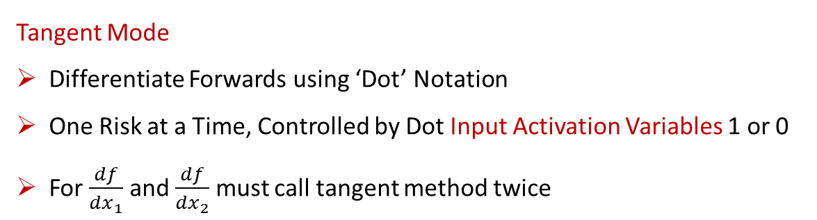
Yield Curves – AD Tangent Mode Example
(Reference)
Tangent Mode
Differentiate Forwards using ‘Dot’ Notation
One Risk at a Time, Controlled by Dot Input Activation Variables 1 or 0
For $\frac{df}{dx_{1}}$ and $\frac{df}{dx_{2}}$ must call tangent method twice
Source Code: https://onlinegdb.com/kKqaS6hJT

Slide 29
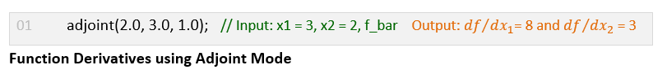
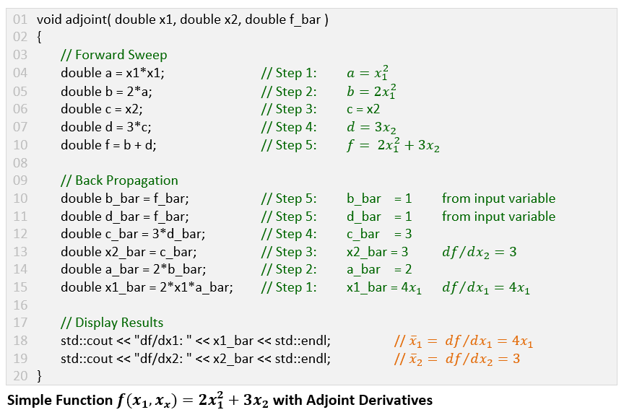
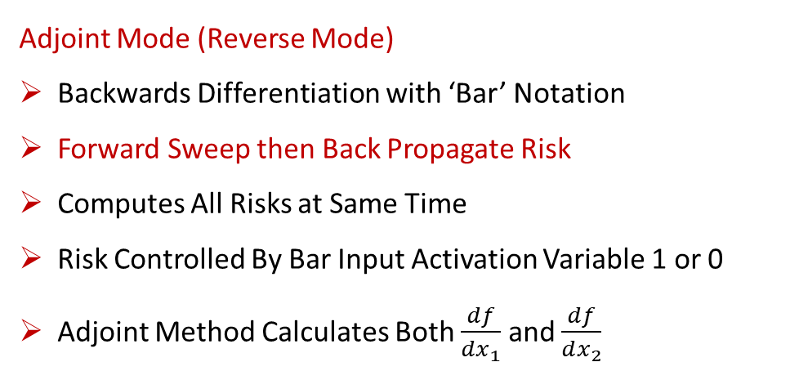
Yield Curves – AD Adjoint Mode Example
(Reference)
Adjoint Mode (Reverse Mode)
Backwards Differentiation with ‘Bar’ Notation
Forward Sweep then Back Propagate Risk
Computes All Risks at Same Time
Risk Controlled By Bar Input Activation Variable 1 or 0
Adjoint Method Calculates Both $\frac{df}{dx_{1}}$ and $\frac{df}{dx_{2}}$
Source Code: https://onlinegdb.com/kKqaS6hJT

Slide 30
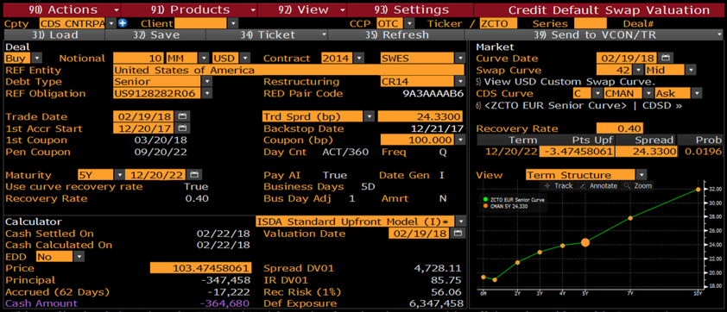
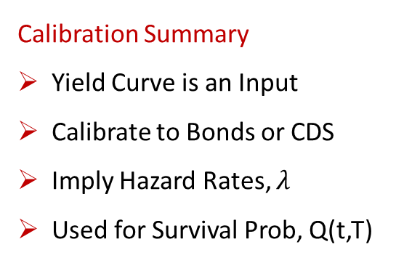
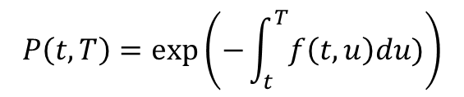


Credit Models – Hazard Rates & Survival Probabilities
(Reference)
Calibration Summary
Yield Curve is an Input
Calibrate to Bonds or CDS
Imply Hazard Rates, $λ$
Used for Survival Prob, Q(t,T)
Common Assumptions
Piecewise Constant¹
Deterministic Hazard Rates
Rule of Thumb
$$λ= \frac{s}{(1−R)}$$
$$Q\left(t,T\right)=exp\left(−\int_{t}^{T}{λ\left(t,u\right)du}\right)$$
$$P\left(t,T\right)=exp⁡\left(−\int_{t}^{T}{f\left(t,u\right)du)}\right)$$
¹ As often there is only a single calibration instrument

Slide 31
PART TWO – PRICING & PRACTICE
Case Studies

Slide 32




Interest Rate Swap – Annuity is the Key Pricing & Risk Factor
It’s All About Annuity
Pricing & Risk Expressed in Terms of Annuity
Similarly Float Legs Expressed in Annuity Terms
Can Be Used to Convert a Float Leg to Fixed Leg
Useful for Low Latency Pricing
$$A_{N}= N\sum_{i=1}^{n}{τ_{i}P\left(t_{0},t_{i}\right)}$$
Low Latency Interest Rate Swap Pricing
Electronic Rates Markets & Low Latency Interest Rate Swap Calculations (May 31, 2022).
Available at SSRN: https://ssrn.com/abstract=4125565
Key Formulae:
PV = ( r – p ) Annuity(Fixed)
Par Rate = PV(Float) / Annuity(Fixed)
PV01 = Annuity(Fixed) x 0.01%
DV01 = PV01 + DF01 = PV01 for Par Swaps
$$Swap PV={PV}^{Fixed Leg}−{PV}^{Float Leg}$$
$$=r\sum_{i=1}^{n}{N_{i}τ_{i}P\left(t_{0},t_{i}\right)}−\sum_{j=1}^{m}{N_{j}l_{j−1}τ_{j}P\left(t_{0},t_{j}\right)}$$
$$=\left(r−p\right)A_{Fixed}$$

Slide 33





Interest Rate Swap – Pricing & Risk Example
(Reference)
Compute Annuity $A_{N}$
= USD 4,863,971.74
$$A_{N}= N\sum_{i=1}^{n}{τ_{i}P\left(t_{0},t_{i}\right)}$$
PV = ( r – p ) $A_{N}$
= (5.00% - 1.59%) $A_{N}$
= USD 167,892.11
Par Rate = PV(Float) / $A_{N}$
= 75,306 /$A_{N}$
= 1.5482%
PV01
= $A_{N}×0.01\%$
= USD 486.40

Slide 34
Asset Swap - Structuring
Trader Creates Synthetic Asset Swap
Borrow Cash from Treasury to Purchase Bond
Buy Bond
Buy CDS Protection (or Carries Credit Risk Unhedged)
Trader Cash Flows
Pays Treasury Funding
Pays CDS Premium
Receives Bond Coupons and Passes on to Client
Client Pays All Costs + Commission as a Spread over LIBOR (or RFR)

Slide 35

Asset Swap – Pricing as a Spread Over LIBOR (or RFR)
ASW Spread - Par-Par Spread
MMS Spread - Yield-Yield Spread¹
¹ Y/Y Spread Between Swap Rate and Benchmark Gov’t Bond Yield

Slide 36


Asset Swap – Pricing using Par-Par Method
(Reference)
Pricing as a PV
Valuation Method for Existing Swaps, Unwinds and Novations (trade transfers)
Again Present Value is Simply the Sum of Incoming and Outgoing Cash Flows
An Upfront Par-Adjustment is Made if the Underlying Bond not Trading at Par, i.e., 100
$${PV}^{Asset Swap}=\underset{Fixed Leg}{\underbrace{ϕr^{Fixed}\sum_{i=1}^{n}{N_{i}τ_{i}P\left(t_{0} , t_{i}\right)}}}−\underset{Float Letg}{\underbrace{ϕ\sum_{j=1}^{m}{N_{j}{\left(l_{j−1}+s\right)τ}_{j}P\left(t_{0} , t_{j}\right)}}}+\underset{Par Adjustment}{\underbrace{ϕN_{1}\left(\frac{100−B}{100}\right)}}$$
Pricing as a Par Spread
New Asset Swaps Price to Par i.e., zero
Instead Quote as a Par Spread s
Rearrangement of PV formula with PV=0
$$s=\left(\frac{\left(r^{Fixed}−p^{Market}\right)A^{Fixed}+\left(\frac{100−B}{100}\right)}{A^{Float}}\right)$$

Slide 37
Pricing Tricks & Rules of Thumb
Annuity Assumption
Need to know market par rates for standard swap maturities
Assume Annual Coupons and Discount Factors = 1.0
This means Annuity = Time to Maturity
Interest Rate Swap PV
PV = N ( r – p ) A(Fixed)
Approximate PV
PV = N Δr T
This gives PV as USD 100 per Million per Year per Δr in bps
IRS Rule of Thumb
PV = 100 x ΔN x Δr x ΔT
DV01 = PV01 = 100 x ΔN x ΔT

Slide 38
Pricing Tricks – Interest Rate Swap
IRS – Rule of Thumb
PV = 100 x ΔN x Δr in bps x ΔT
DV01 = PV01 = 100 x ΔN x ΔT
Market Par Rate
5Y Par Rate = 150 bps
Δr = (r-p) = (500-150) = 350 bps
Present Value
Here ΔN = 1, Δr = 350, ΔT = 5
PV = USD 175,000
DV01 = PV01 = USD 500
PV = 100 x 1 x 350 x 5 = USD 170K
DV01 = 100 x 1 x 5 = USD 500

Slide 39

Pricing Tricks – Asset Swap
(Reference)
We Can Make the Same Annuity Assumption to Price Asset Swaps
Par-Par Spread
$$s=\left(\frac{\left(r^{Fixed}−p^{Market}\right)A^{Fixed}+\left(\frac{100−B}{100}\right)}{A^{Float}}\right)$$
IRS Rule of Thumb
s = ( r – p ) + (100-B/100) / T
= Δr – (ΔB / T)
where Δr = ( r – p ) in bps
and ΔB = (B% - 100%) in bps
Par-Par Spread
Here Δr = 0.50% – 0.44% = 6 bps, ΔB = 458 bps and T = 10
S = 6 – (458/10) ≈ 6 - 46 = -40 bps

Slide 40



References
Quant Research Papers
https://ssrn.com/author=1728976
Support Materials, C++ & Excel Examples
https://github.com/nburgessx/SwapsBook

Slide 41




Appendix – Implicit Function Theorem (IFT)
For an Interest Rate Swap
$$Par Rate, p= \frac{PV\left(Float Leg\right)}{\sum_{i=1}^{n}{N τ_{i} P\left(t_{0},t_{i}\right)}}= \frac{\sum_{j=1}^{m}{N\left( l_{j−1}+s\right) τ_{j} P\left(t_{0},t_{j}\right)}}{Annuity(Fixed)}$$
The derivative with respect to L is trivial to calculate
We can calculate for any set of calibration instruments
This allows us to modify and select any risk & hedge buckets

Slide 42

Appendix – Swap DV01 Risk Example using AAD (Part I)
IRS Present Value Code
Swap Price Implementation
Simplified for Demo Purposes
For Full Example See
https://bit.ly/SwapCodeAAD

Slide 43

Appendix – Swap DV01 Risk Example using AAD (Part II)
Analytical DV01 Risk
Using Adjoint Mode (AAD)
Forward Sweep for Price
Back Propagation for Risk
Simultaneous Forward and Discount Risk
Source Code: https://www.onlinegdb.com/edit/al8aNASJnQ

Slide 44
Contact
Have questions or want further info?
LinkedIn: www.linkedin.com/in/nburgessx

